Slide 1

Lecture Overview
Review discrete-time modeling, feedback, and control.
Practice translating between transfer functions, difference equations, and state-space models.
Revise PI and PIP controller design and their effects on system dynamics.
Understand how integral action ensures zero steady-state error.
Discuss pole placement, controllability, and robustness in digital control.

Slide 2
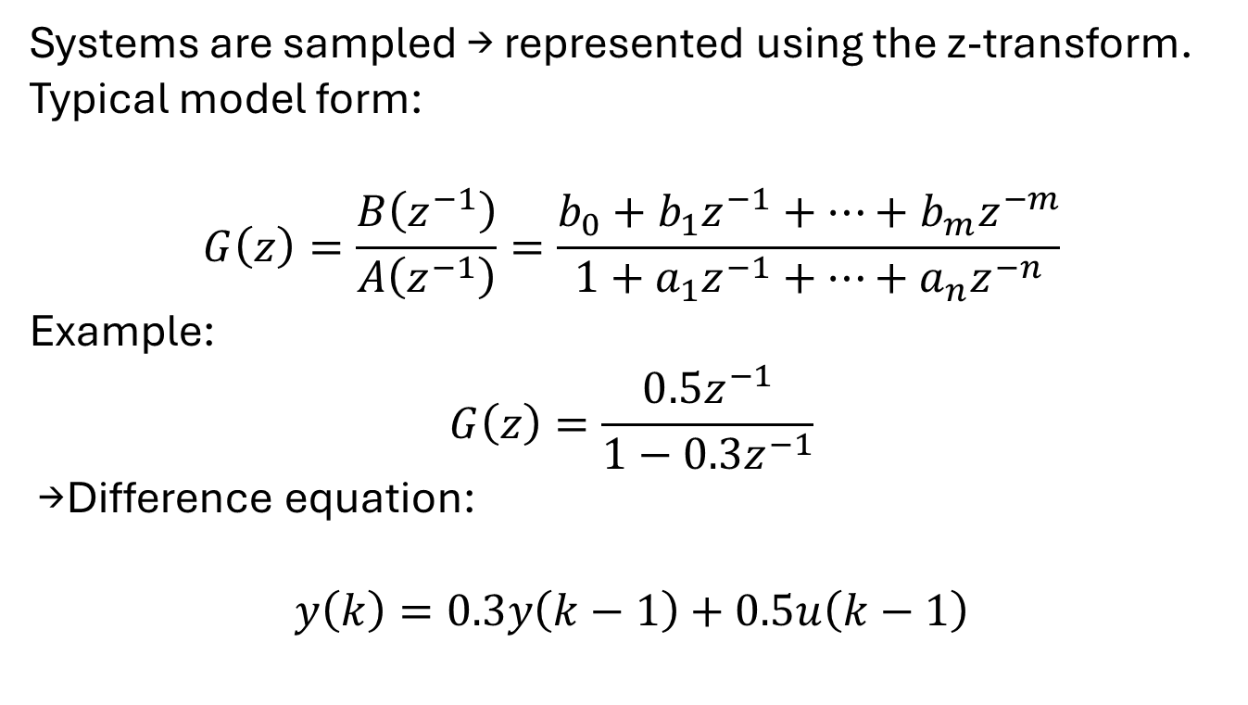
Discrete-Time Systems
Systems are sampled → represented using the z-transform.
Typical model form:
$$G\left(z\right)=\frac{B\left(z^{−1}\right)}{A\left(z^{−1}\right)}=\frac{b_{0}+b_{1}z^{−1}+⋯+b_{m}z^{−m}}{1+a_{1}z^{−1}+⋯+a_{n}z^{−n}}$$
Example:
$$G\left(z\right)=\frac{0.5z^{−1}}{1−0.3z^{−1}}$$
→ Difference equation:
$$y\left(k\right)=0.3y\left(k−1\right)+0.5u\left(k−1\right)$$
What is the order of this system? What happens if the pole moves closer to 1?”

Slide 3
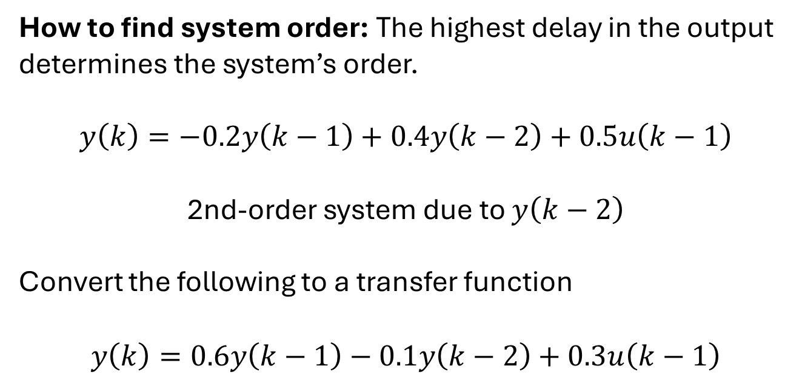
Difference Equations & System Order
How to find system order: The highest delay in the output determines the system’s order.
$$y\left(k\right)=−0.2y\left(k−1\right)+0.4y\left(k−2\right)+0.5u\left(k−1\right)$$
2nd-order system due to $y\left(k−2\right)$
Convert the following to a transfer function
$$y\left(k\right)=0.6y\left(k−1\right)−0.1y\left(k−2\right)+0.3u\left(k−1\right)$$
How do the coefficients affect response speed and damping?

Slide 4
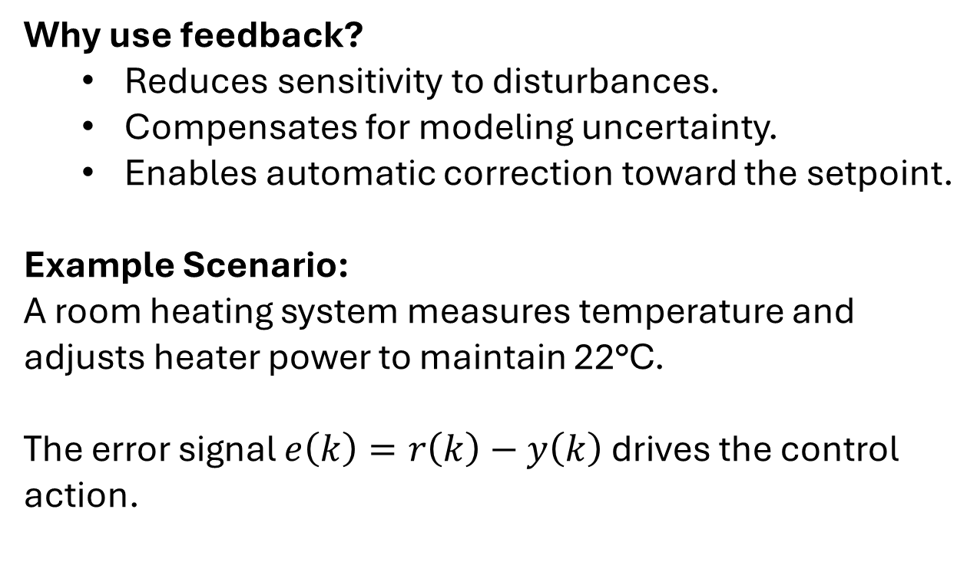
Feedback Control Concept
Why use feedback?
Reduces sensitivity to disturbances.
Compensates for modeling uncertainty.
Enables automatic correction toward the setpoint.
Example Scenario:
A room heating system measures temperature and adjusts heater power to maintain 22°C.
The error signal $e\left(k\right)=r\left(k\right)−y\left(k\right)$ drives the control action.
What happens if feedback is removed?

Slide 5
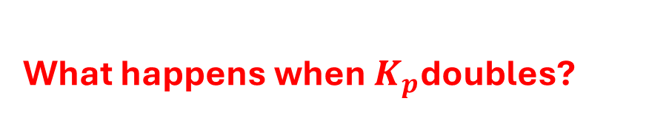
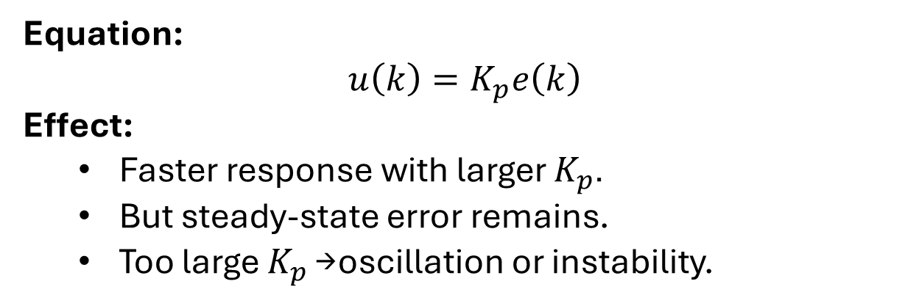
Proportional (P) Control
Equation:
$$u\left(k\right)=K_{p}e\left(k\right)$$
Effect:
Faster response with larger $K_{p}$.
But steady-state error remains.
Too large $K_{p}$→ oscillation or instability.
What happens when $K_{p}$doubles?

Slide 6
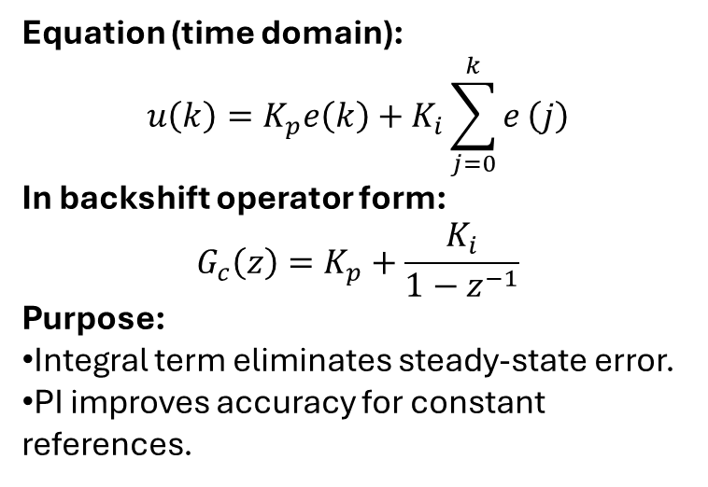
Proportional-Integral (PI) Control
Equation (time domain):
$$u\left(k\right)=K_{p}e\left(k\right)+K_{i}\sum_{j=0}^{k}{e}\left(j\right)$$
In backshift operator form:
$$G_{c}\left(z\right)=K_{p}+\frac{K_{i}}{1−z^{−1}}$$
Purpose:
Integral term eliminates steady-state error.
PI improves accuracy for constant references.
Why does the integral term reduce steady-state error to zero?

Slide 7
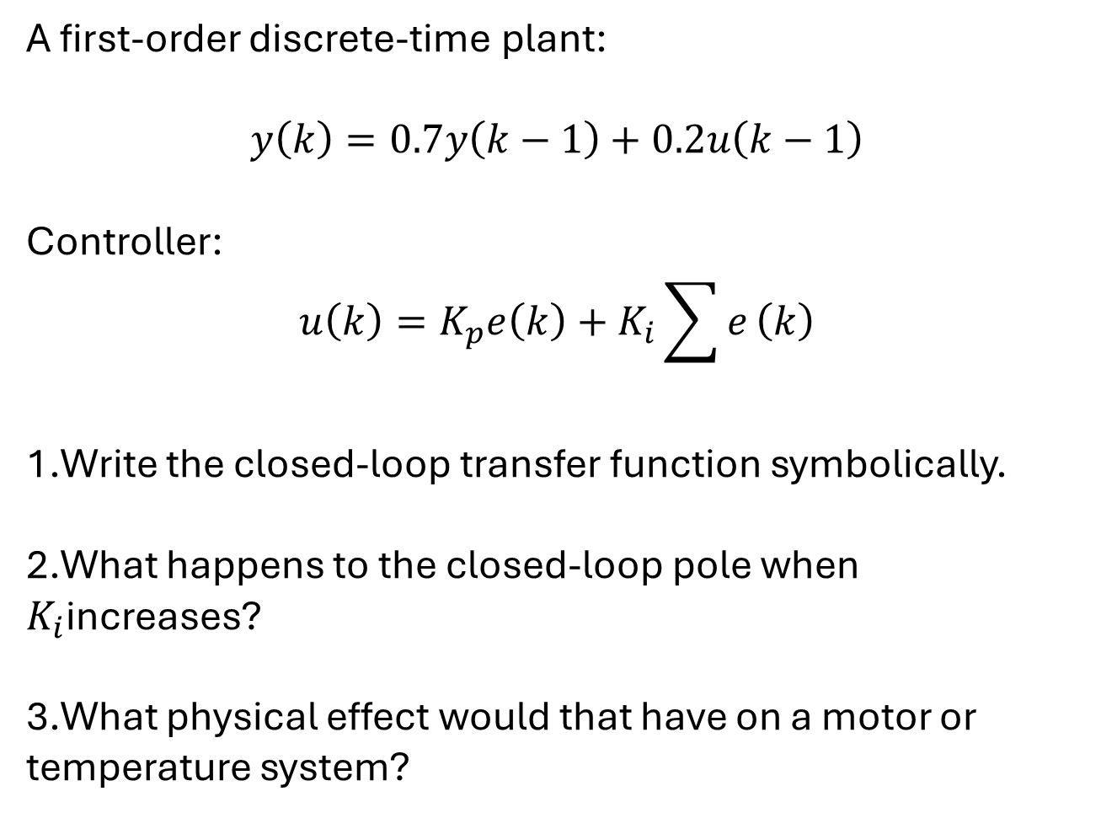
Practice Example: PI Control
A first-order discrete-time plant:
$$y\left(k\right)=0.7y\left(k−1\right)+0.2u\left(k−1\right)$$
Controller:
$$u\left(k\right)=K_{p}e\left(k\right)+K_{i}\sum{e}\left(k\right)$$
Write the closed-loop transfer function symbolically.
What happens to the closed-loop pole when $K_{i}$increases?
What physical effect would that have on a motor or temperature system?

Slide 8
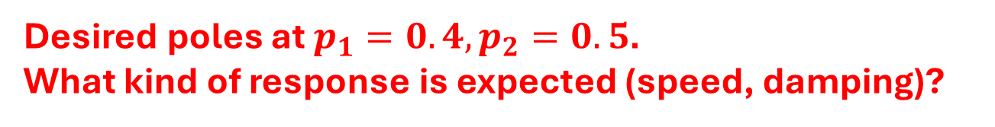
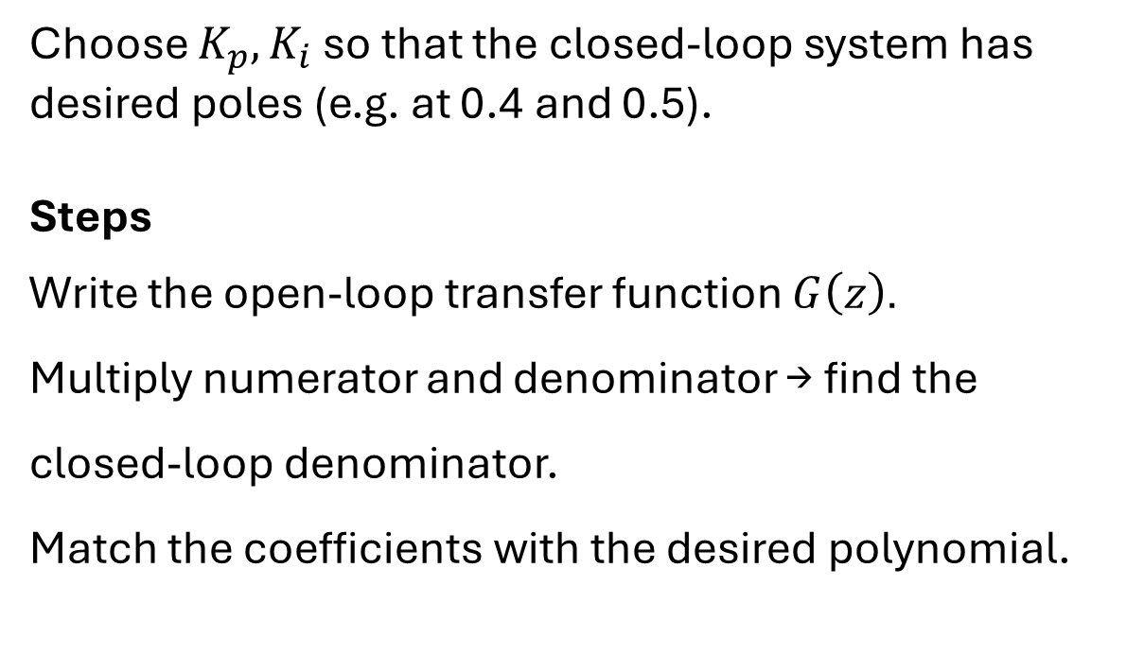
PI Tuning and Pole Placement
Choose $K_{p},K_{i}$ so that the closed-loop system has desired poles (e.g. at 0.4 and 0.5).
Steps
Write the open-loop transfer function $G\left(z\right)$.
Multiply numerator and denominator → find the closed-loop denominator.
Match the coefficients with the desired polynomial.
Desired poles at $p_{1}=0.4,p_{2}=0.5$.
What kind of response is expected (speed, damping)?

Slide 9
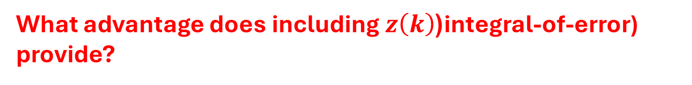
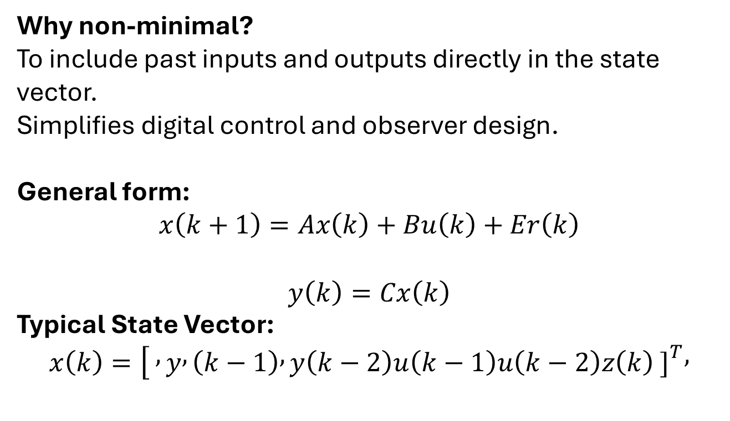
NMSS (Non-Minimal State-Space)
Why non-minimal?
To include past inputs and outputs directly in the state vector.
Simplifies digital control and observer design.
General form:
$$x\left(k+1\right)=Ax\left(k\right)+Bu\left(k\right)+Er\left(k\right)$$
$$y\left(k\right)=Cx\left(k\right)$$
Typical State Vector:
$$x\left(k\right)=[ , y , \left(k−1\right) , y\left(k−2\right)u\left(k−1\right)u\left(k−2\right)z\left(k\right) {\left.]\right.}^{T},$$
What advantage does including $z\left(k\right)$(integral-of-error) provide?

Slide 10
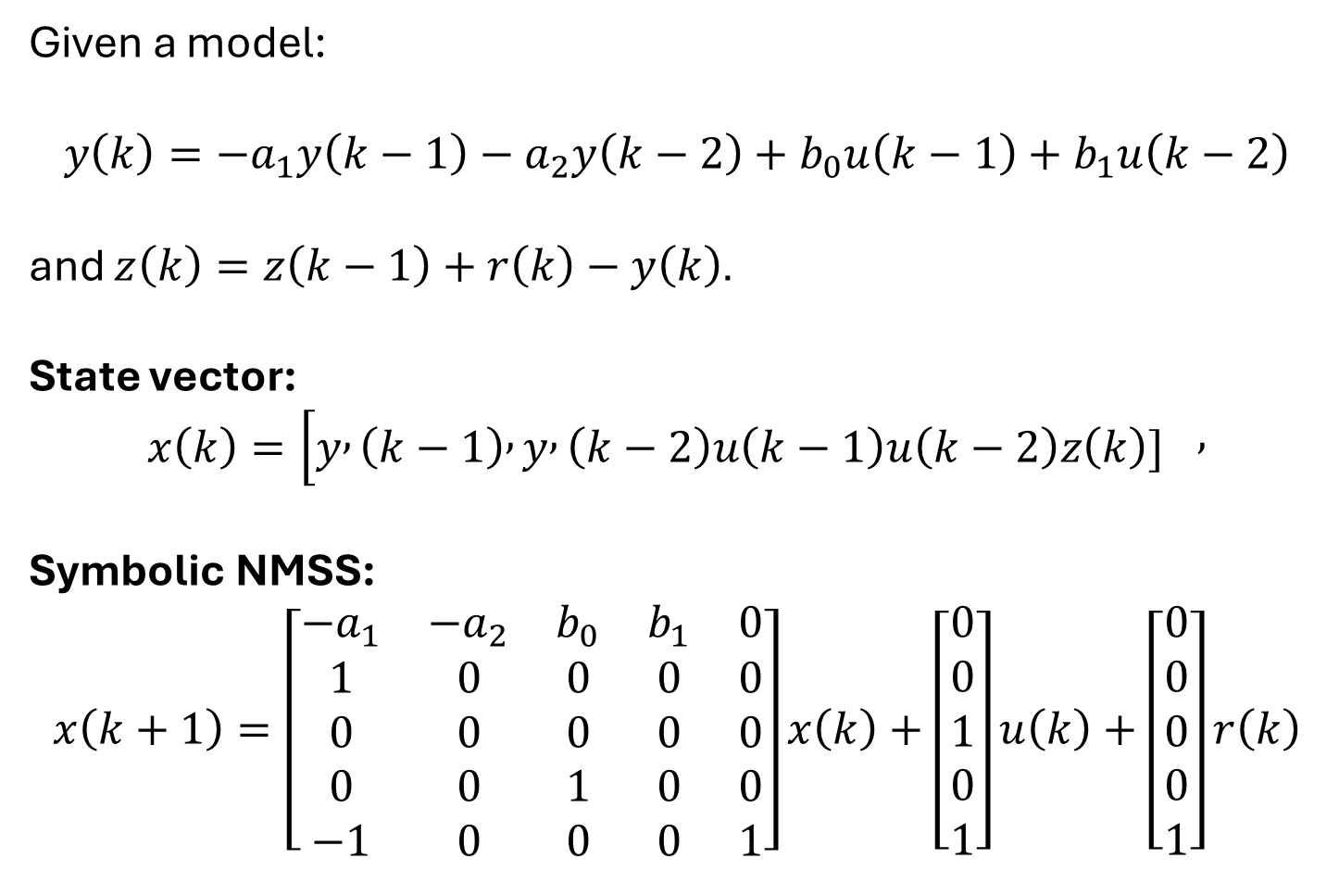
Example- NMSS Construction
Given a model:
$$y\left(k\right)=−a_{1}y\left(k−1\right)−a_{2}y\left(k−2\right)+b_{0}u\left(k−1\right)+b_{1}u\left(k−2\right)$$
and $z\left(k\right)=z\left(k−1\right)+r\left(k\right)−y\left(k\right)$.
State vector:
$$x\left(k\right)=[y , \left(k−1\right) , y , \left(k−2\right)u\left(k−1\right)u\left(k−2\right)z\left(k\right){\left.]\right.}^{},$$
Symbolic NMSS:
$$x\left(k+1\right)=\left[\begin{matrix}−a_{1} & −a_{2} & b_{0} & b_{1} & 0 \\ 1 & 0 & 0 & 0 & 0 \\ 0 & 0 & 0 & 0 & 0 \\ 0 & 0 & 1 & 0 & 0 \\ −1 & 0 & 0 & 0 & 1\end{matrix}\right]x\left(k\right)+\left[\begin{matrix}0 \\ 0 \\ 1 \\ 0 \\ 1\end{matrix}\right]u\left(k\right)+\left[\begin{matrix}0 \\ 0 \\ 0 \\ 0 \\ 1\end{matrix}\right]r\left(k\right)$$

Slide 11
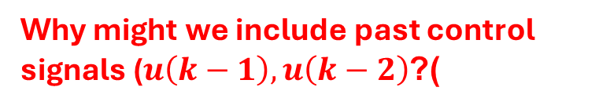
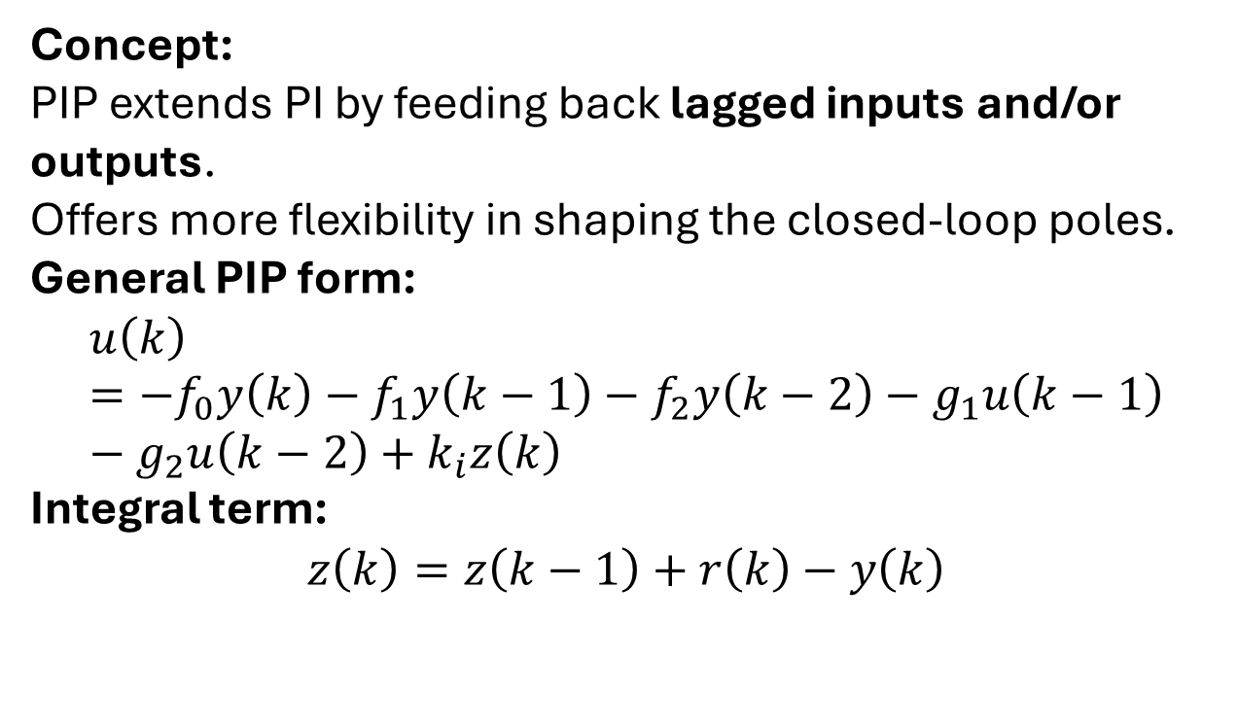
PIP (Proportional–Integral–Plus) Control
Concept:
PIP extends PI by feeding back lagged inputs and/or outputs.
Offers more flexibility in shaping the closed-loop poles.
General PIP form:
$$u\left(k\right)=−f_{0}y\left(k\right)−f_{1}y\left(k−1\right)−f_{2}y\left(k−2\right)−g_{1}u\left(k−1\right)−g_{2}u\left(k−2\right)+k_{i}z\left(k\right)$$
Integral term:
$$z\left(k\right)=z\left(k−1\right)+r\left(k\right)−y\left(k\right)$$
Why might we include past control signals ($u\left(k−1\right),u\left(k−2\right)$)?

Slide 12
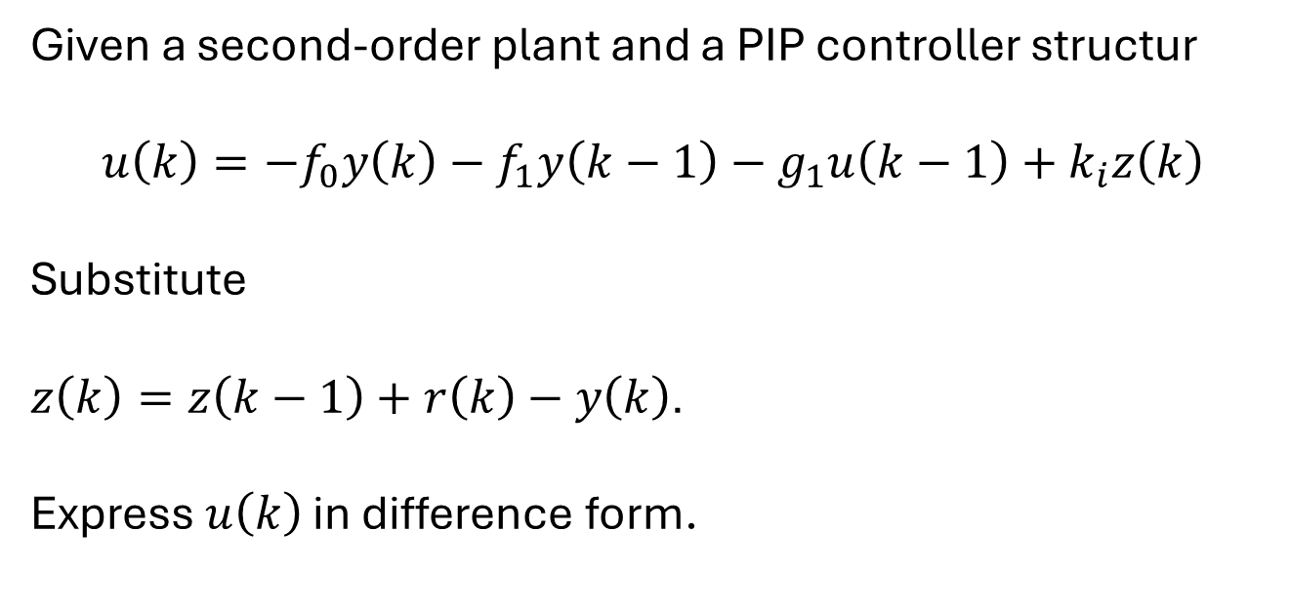
PIP Controller Practice Example
Given a second-order plant and a PIP controller structur
$$u\left(k\right)=−f_{0}y\left(k\right)−f_{1}y\left(k−1\right)−g_{1}u\left(k−1\right)+k_{i}z\left(k\right)$$
Substitute
$z\left(k\right)=z\left(k−1\right)+r\left(k\right)−y\left(k\right)$.
Express $u\left(k\right)$ in difference form.
Discuss how increasing $k_{i}$ affects steady-state error.

Slide 13
Pole Placement in PIP Control
PI → can place one closed-loop pole (for first-order systems).
PIP → can place multiple closed-loop poles (for higher-order systems).
What additional degree of freedom does PIP introduce compared to PI?
How can we exploit this to improve damping and transient performance?

Slide 14
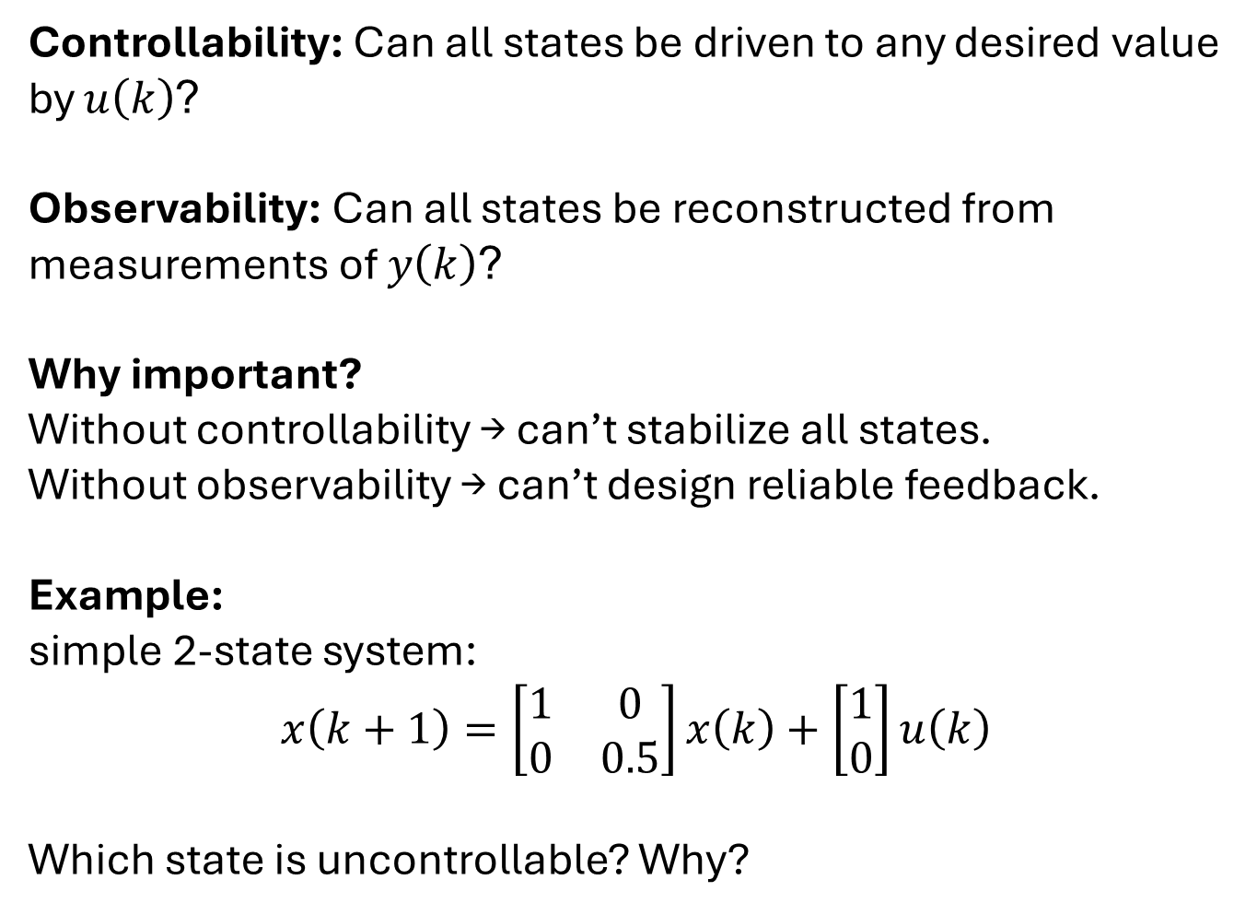
Controllability & Observability
Controllability: Can all states be driven to any desired value by $u\left(k\right)$?
Observability: Can all states be reconstructed from measurements of $y\left(k\right)$?
Why important?
Without controllability → can’t stabilize all states.
Without observability → can’t design reliable feedback.
Example: simple 2-state system:
$$x\left(k+1\right)=\left[\begin{matrix}1 & 0 \\ 0 & 0.5\end{matrix}\right]x\left(k\right)+\left[\begin{matrix}1 \\ 0\end{matrix}\right]u\left(k\right)$$
Which state is uncontrollable? Why?

Slide 15
Performance vs. Robustness
Key Trade-off:
Faster → more sensitive to noise and model error.
Slower → more stable and robust.
Example:
Drone altitude controller (fast, risky).
Temperature controller (slow, robust).
What might happen if you double $K_{p}$or halve $K_{i}$?

Slide 16
Summary
PI control removes steady-state error.
PIP extends PI by adding lagged variable feedback.
NMSS allows simple digital implementation of control laws.
Pole placement gives direct control over system speed.
Balance performance and robustness for real-world success.

